Slide 1
Protein-protein interaction data and databases

Slide 2
Useful materials
Protein interaction and their importance (Train online, EMBL-EBI):
https://www.ebi.ac.uk/training/online/course/protein-interactions-and-their-importance

Slide 3
Learning outcomes
List the main experimental methodologies used to generate PPI data
Tell the limitations that these methodologies have
Explain the concept of interaction data quality and how it is used to «score» interactions for their reliability
Describe the different classes of PPI databases and their features
Make an example for each class of PPI database
Use IntAct and STRING to identify partners of interaction of an input protein

Slide 4
Our plan
Where do molecular interaction data come from?
Methods to detect protein interactions
PPI databases and tools
FAIR data and standards
IntAct
STRING

Slide 5
Where do molecular interaction data come from?

Slide 6
Where do molecular interaction data come from?
Experimental approaches
Computational methods

Slide 7
Experimental molecular interaction data
Molecular interaction data can be generated using many different techniques, all of which have their strengths and weaknesses
All molecular interaction data is to some degree artifactual
No single method can accurately reproduce a true binary interaction observed under physiological conditions

Slide 8
Methods to detect PPI data
A variety of techniques and methods have been developed to generate PPI data.
High throughput techniques
They provide information on several thousand pairwise interactions at a time
The increasingly wide availability of high throughput techniques has generated a huge amount of interaction data
Interactome: a global 'snapshot' in a cell, an organism or as particular physiological contex
Low throughput techniques
Time consuming
Provide deeper insight into certain characteristic of an interaction
Data are more accurate and reliable

Slide 9
Methods to detect PPI data
High throughput techniques
Yeast two-hybrid (Y2H)
Affinity purification mass spectrometry (AP-MS)
Medium-throughout techniques
Co-immunoprecipitation (co-IP)
Low throughput techniques
Fluorescence Resonance Energy Transfer (FRET)
Surface Plasmon Resonanc (SPR)
Isothermal titration calorimetry (ITC)
NMR
X-ray crystallography

Slide 10
Methods to detect PPIs
These techniques can be further divided in:
Binary methods: techniques detecting direct physical associations between two proteins
Co-complex methods: techniques detecting interactions among groups of proteins that may not be in physical contact

Slide 11
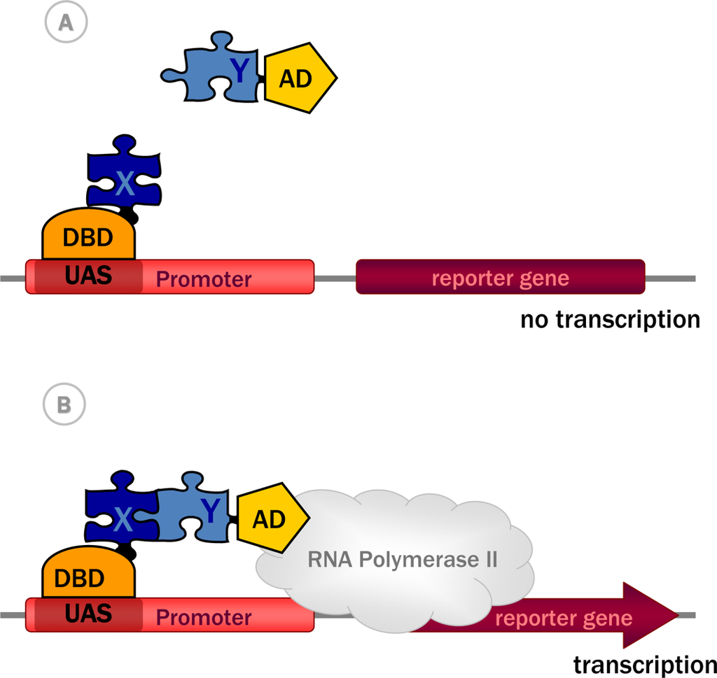
Yeast two-hybrid (Y2H)
Main binary method to detect direct physical interactions between protein pairs
Transcription factor:
DNA-binding domain (DBD)
DNA-activation domain (AD)
BD and AD fused to bait (X) and prey (Y)
If X and Y do interact, readout can take place
Transcription machinery becomes activated
A reporter gene is turned on
From Yeast Two-Hybrid, a Powerful Tool for Systems Biology, Anna Brückner , Cécile Polge, Nicolas Lentze, Daniel Auerbach and Uwe Schlattner, Int. J. Mol. Sci. 2009

Slide 12
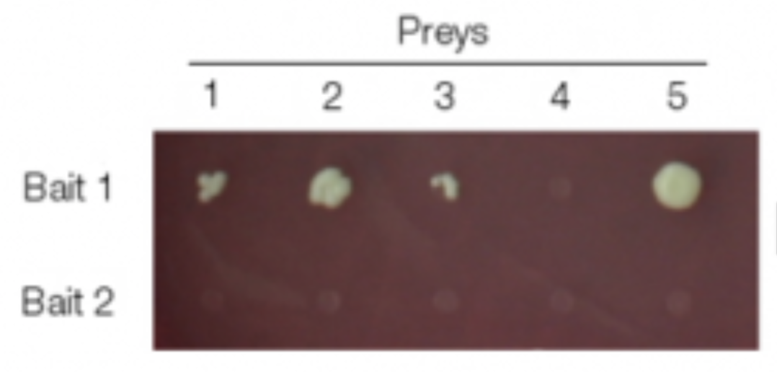
Yeast two-hybrid (Y2H)
Example: positive interactions are shown by colony growth
Figure from Koh et al. Analyzing protein-protein interaction networks. J. Proteome Res. 2012 Apr; 11 (4): 2014-31

Slide 13
Yeast two-hybrid (Y2H)
Advantages:
Fast
Inexpensive
Scalable
An in vivo system in which binding sites can be accurately mapped
Disadvantages:
False positives when a yeast protein acts as a bridge for the interaction
Interaction between proteins normally belonging to different cellular compartments, cell types, or are not expressed at the same time
Bait and/or prey can fail to be expressed or might be toxic to the cell

Slide 14
Affinity purification mass spectrometry (AP-MS)
Specificity and sensitivity depend on the strength and stability of the interactions between the proteins involved
The interacting partners are detected by mass spectrometry

Slide 15
Affinity purification mass spectrometry (AP-MS)
Advantages:
Can examine interactions among multiple proteins at subpicomole concentrarions
Prey proteins are present in their native state and concentration
Disadvantages:
Some proteins may not be identified by MS
Proteins without a peptide signature recognizable by MS
Proteins present in very low amounts
Transient and weak interactions may be missed
Possible false positives due to mixing of compartments during cell lysis/purification

Slide 16
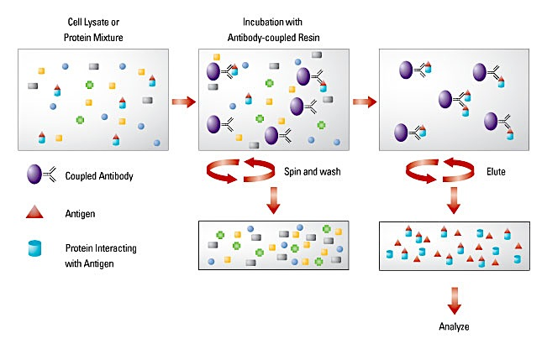
co-immunoprecipitation (co-IP)
Traditional considered as the gold standard assay for PPIs
A protein complex can be isolated from a protein mixture by using an antibody that is specific for one protein of the complex
In this approach, the bait protein, usually expressed in the cell in vivo conditions, is affinity purified and the interacting partners are detected by mass spectrometry.
Pros and cons are similar to those of affinity purification mass spectrometry

Slide 17
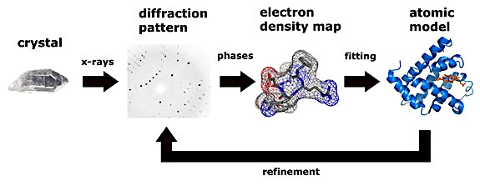
X-Ray crystallography
It is considered the gold standard for PPIs, since it provides high quality data for binding surfaces to the level of individual atoms and binding sites.
Figure from Thomas Splettstoesser (www.scistyle.com)

Slide 18
X-Ray crystallography
Advantages:
Provides an extremely deep level of detail about interacting surface and residues
Provides very high quality data
Disadvantages:
Extremely challenging technically
Very low-throughput (expensive)
Not free from false negatives or false positives
Not every protein can be co-crystallised
Some proteins that co-crystallise in vitro do not interact in vivo
Proteins live in solution

Slide 19
PPI databases
Understanding and using PPI data relies on:
Data retrieval
Data organisation
Data analysis
An enormous effort is required to store PPI data in a way that is both accssible and intellegible to the user

Slide 20



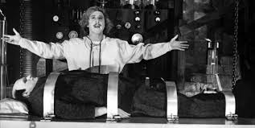


Databases and curation
An enormous effort is required to store PPI data in a way that is both accssible and intellegible to the user
Wet Lab Scientists
Scientific Curators
Molecular Interaction DataBases

Slide 21
Molecular Interaction Databases
Molecular interaction databases have been established to collect, archive and disseminate molecular interaction data in a structured format to perform searches and bioinformatics analyses

Slide 22
FAIR data
Findable
Accessible
Interoperable
Reusable
FAIR principles: https://www.go-fair.org/fair-principles/

Slide 23
Molecular Interaction Databases
Molecular interaction databases can be classified into three main types, according to their data-acquisition policies:
Primary databases: experimentally determined protein interactions coming from either small- or large-scale published studies that have been manually curated. Examples: IntAct, MINT, BioGRID, MatrixDB
Secondary or Meta databases: experimentally determined PPIs obtained by consistent integration of several primary databases. Examples: APID, PINA
Prediction databases: combine experimentally inferred data taken from primary databases with computational predictions or molecular interactions. Examples: STRING, UniHI
See http://www.pathguide.org

Slide 24
Main Molecular Interaction Databases
A more complete list of molecular
interaction databases is
available at:
http://www.pathguide.org
Luana Licata and Sandra Orchard, The MIntAct Project and Molecular Interaction Databases,
Methods in Molecular Biology Chapter, Springer, in press.

Slide 25
Sable&Jois, Molecules, 2015

Slide 26

IMEx: The International Molecular Exchange Consortium
An international collaboration between a group of major public interaction data providers who have agreed to share curation effort (www.imexconsortium.org)
12 active molecular interaction databases dedicated to producing high quality, annotated data, curated to the same standards and following the same curation rules
Data is curated once at a single centre then exchanged between partners
Users need only go to a single site to obtain all data

Slide 27
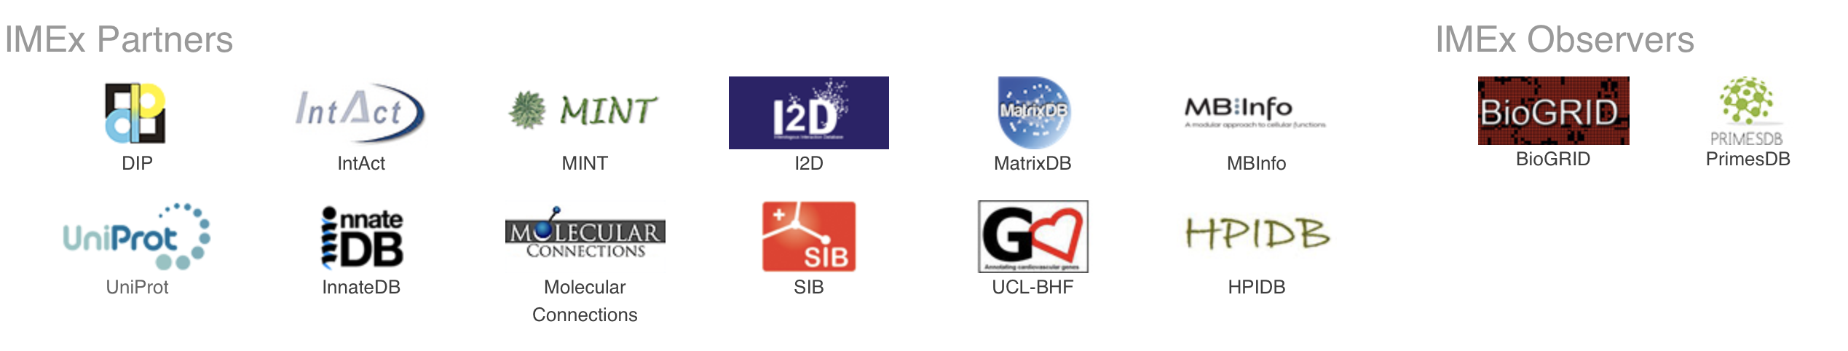
IMEx Data
A non-redundant set of physical molecular interaction data from a broad taxonomic range of organisms.
Expertly curated from direct submissions or peer-reviewed journals to a consistent high standard.
Available in standard formats MITAB or PSI-MI XML 2.5.
Provided by a network of participating major public domain databases.

Slide 28
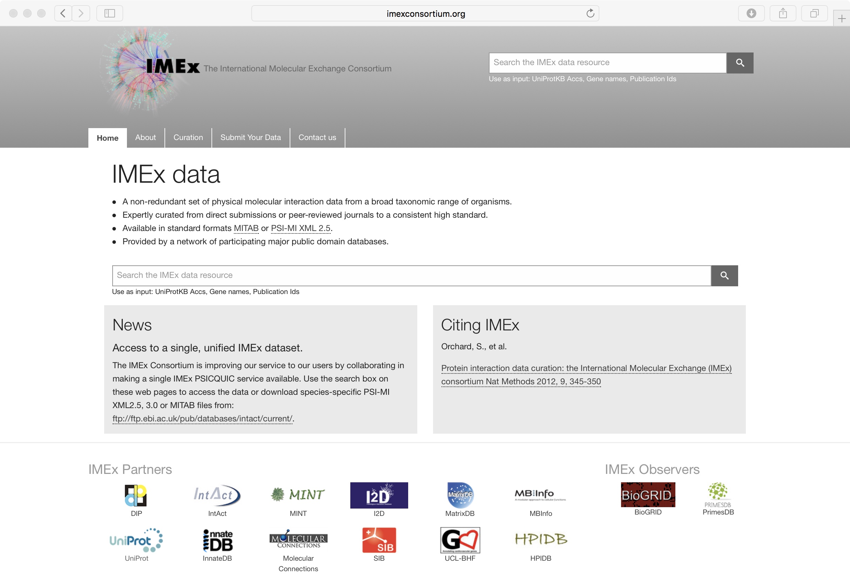
IMEx Consortium

Slide 29
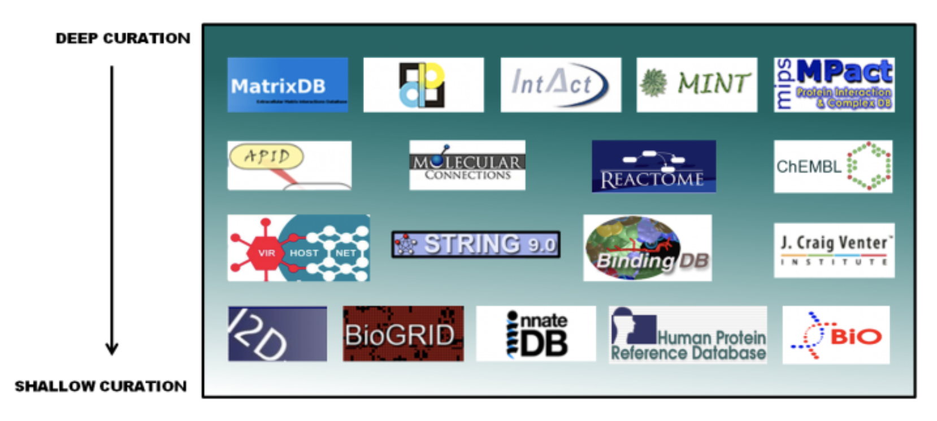
Some molecular interactions and pathways databases organised according to their level of curation
Figure from Train online @ EMBL-EBI

Slide 30

The problem of data integration and an example of a solution: PSICQUIC
Sandra Orchard &
Pablo Porras Millán, IntAct
orchard@ebi.ac.uk
pporras@ebi.ac.uk

Slide 31
Molecular interaction information
Ideally
Reality
DB
DB
DB
DB
DB
I
I
I
I
I
Database
I
Interface
User
S. Orchard & P. Porras Millán, IntAct
Notes:
As a biologist I would prefer to see all the information in one unique database.
Centralized databases have this mission.
The aim to collect all the information for one specific domain.
However …
Medium-size labs and organizations are capable to produce large amounts of data.
Then it becomes harder to submit data to centralized repositories.
Moreover data producers like to control and structure their own databases, developing their own GUI and access protocols.
For us, the users, it becomes harder to access the information.
For one specific domain we might find different databases, using different GUIs. We might end up downloading data in different formats complicating the integration of results. After integration we might find a problem of high redundancy in our results.

Slide 32

Molecular interaction resources
547 resources!
www.pathguide.org/
S. Orchard & P. Porras Millán, IntAct

Slide 33
Data integration
Combining data residing in different sources
… providing users with a unified view of these data.
Ideally
Reality
Compromise
DB
DB
DB
DB
DB
DB
DB
DB
DB
I
I
I
I
I
STANDARDS AND ONTOLOGIES
I
Database
I
Interface
User
S. Orchard & P. Porras Millán, IntAct

Slide 34
Data integration problems
Many data resources
Many to maintain
New appearing
Just 20% has a sustained future*
Not easy to find them
Different query interfaces
Variable results
Formats
Schemas
Controlled vocabularies
Minimum information guidelines
Redundancy
Inconsistency
S. Orchard &
P. Porras Millán, IntAct
data integration?
* Merali et al., 2005, Nature, PMID: 15973369.

Slide 35


Standards
PSI-MI standards
Common identifiers
Controlled vocabularies
Common formats
Common schemas
Minimum information guidelines
Common query interfaces
www.psidev.info/MI
Control vocabulary
Schema
Format
Identifiers
Reporting
guideline
Data distribution
S. Orchard & P. Porras Millán, IntAct
Notes:
The Molecular Interactions workgroup is concentrating on:
improving the annotation and representation of molecular interaction data wherever it is published, be this in journal articles, authors web-sites or public domain databases
improving the accessibility of molecular interaction data to the user community. By using a common standard data can be downloaded from multiple sources and easily combined using a single parser

Slide 36

The danger with standards…
S. Orchard & P. Porras Millán, IntAct
From xkcd: http://xkcd.com/927/

Slide 37
Collaboration among data providers
More data coverage
Less redundancy
Less inconsistency
Better data management
Access, exchange, sharing, portability, interoperability, annotation, comparison, verification, representation, integration, reusability.
IntAct
PRIDE
ENA
…
…
InnateDB
GPMDB
GenBank
DDBJ
MINT
Tranche
DIP
PeptideAtlas
Nucleotide sequences
INSDC
Molecular interactions
IMEx
Protein indentifications
ProteomeXchange
S. Orchard & P. Porras Millán, IntAct

Slide 38
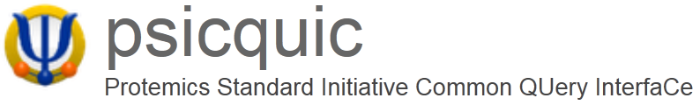
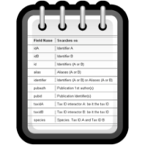


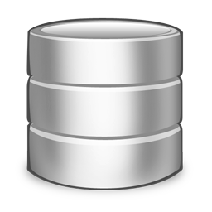

Unified query client: PSICQUIC
www.ebi.ac.uk/Tools/webservices/psicquic/view/main.xhtml
PSI-MI
MIQL
Interactions
Query
input
output
PSICQUIC
S. Orchard & P. Porras Millán, IntAct
PSICQUIC
Service A
PSICQUIC
Service B
PSICQUIC
Service C
PSICQUIC
Registry

Slide 39

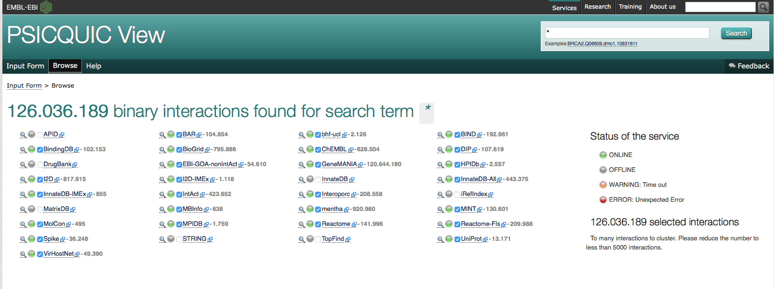
PSICQUIC (PSI Common Query Interface)
PSICQUIC is an effort from the HUPO Proteomics Standard Initiative (HUPO-PSI) to standardize the access to molecular interaction databases programmatically.
It is available at:
http://www.ebi.ac.uk/Tools/webservices/psicquic/view/main.xhtml
and users can obtain results both in MITAB 2.5, 2.6 and 2.7 or PSI-XML formats using the MIQL 2.7 query language

Slide 40




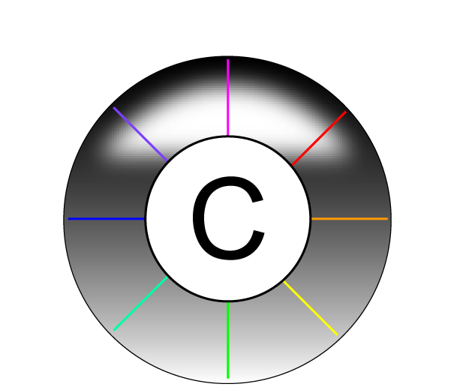





Examples of services using PSICQUIC
www.phisto.org
www.reactome.org
www.cytoscape.org
www.genemania.org
http://mentha.uniroma2.it
http://clipserve.clip.ubc.ca/topfind
http://cbdm.mdc-berlin.de/tools/hippie
www.ebi.ac.uk/Tools/webservices/psicquic/view/main.xhtml
www.bioconductor.org/packages/release/bioc/html/PSICQUIC.html
S. Orchard & P. Porras Millán, IntAct

Slide 41
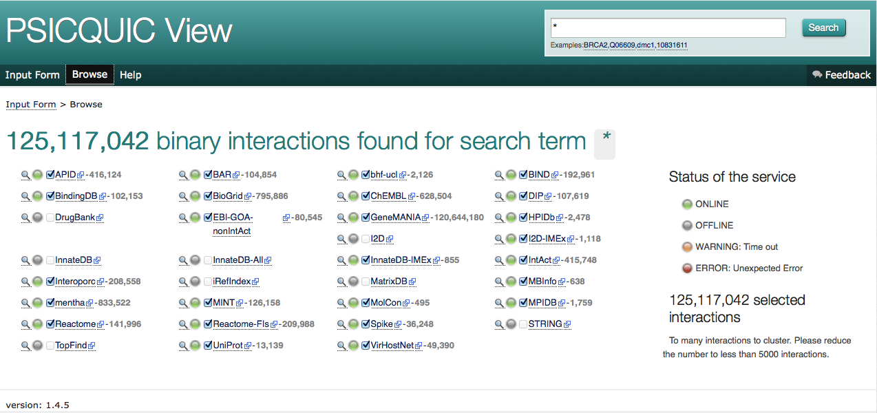
Unified query client interface: PSICQUIC view
www.ebi.ac.uk/Tools/webservices/psicquic/view/main.xhtml
S. Orchard & P. Porras Millán, IntAct

Slide 42
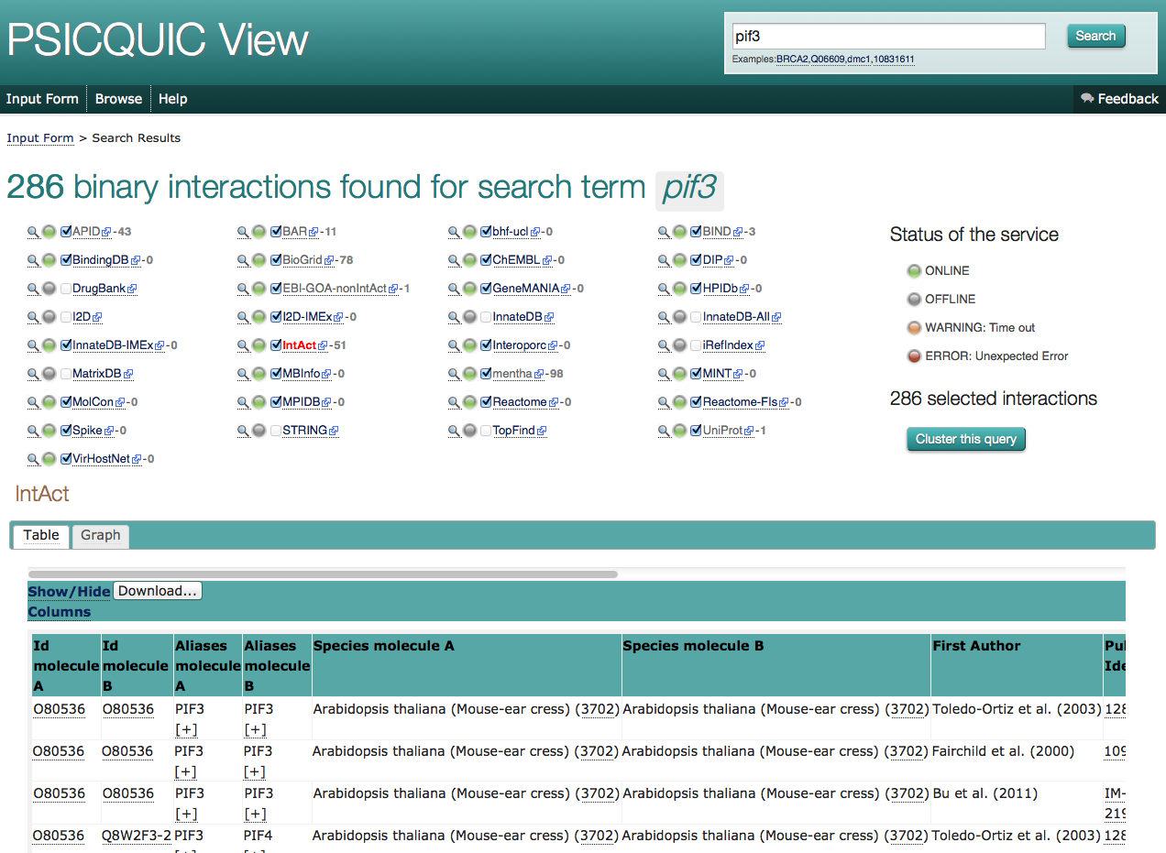
Unified query client interface: PSICQUIC view
S. Orchard &
P. Porras Millán, IntAct

Slide 43
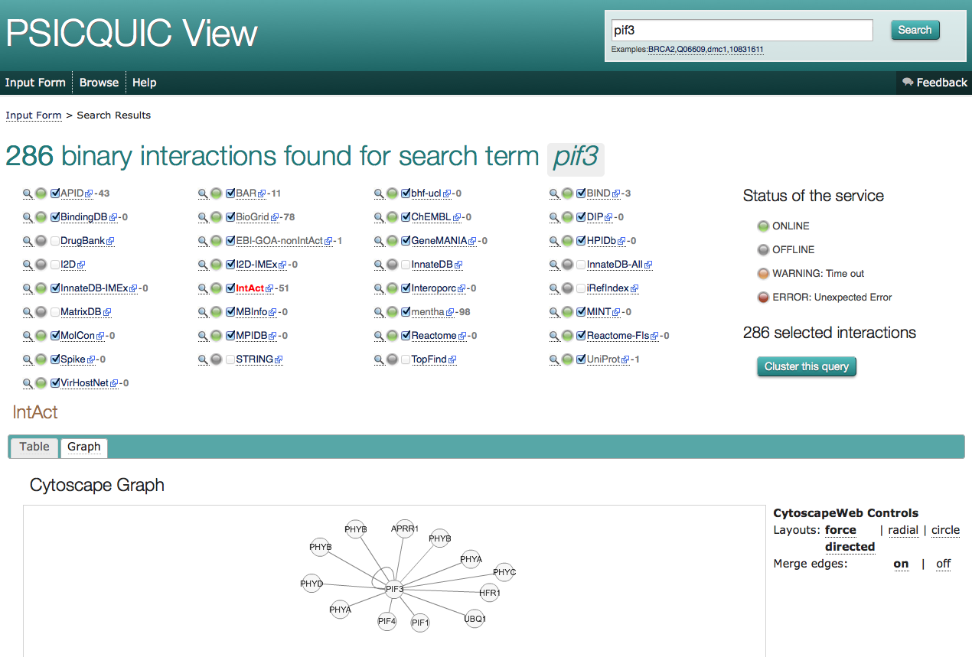
Unified query client interface: PSICQUIC view
S. Orchard & P. Porras Millán, IntAct

Slide 44
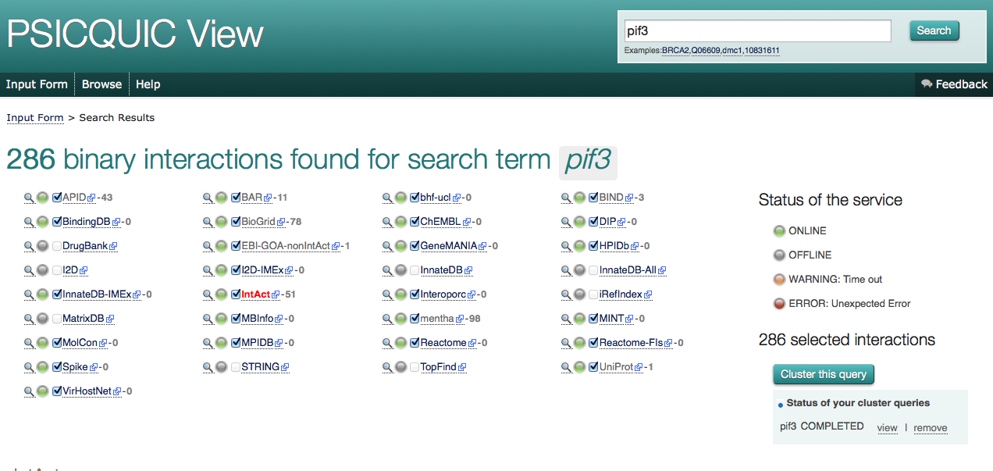
Unified query client interface: PSICQUIC view
S. Orchard & P. Porras Millán, IntAct

Slide 45
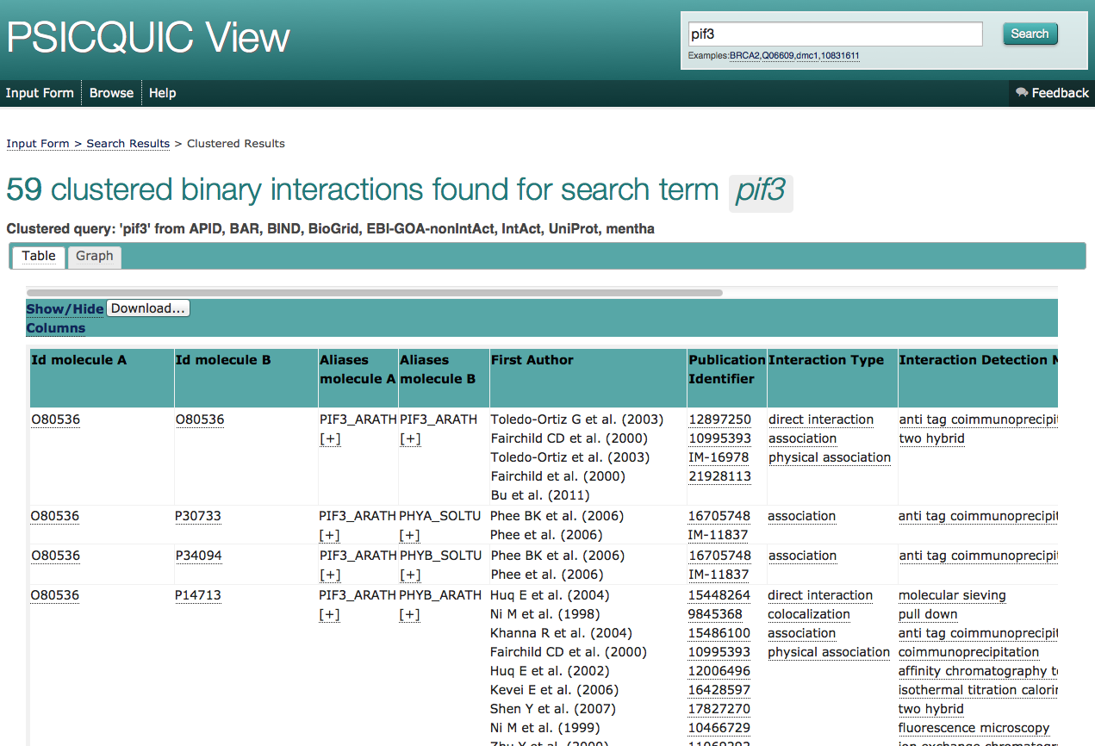
Unified query client interface: PSICQUIC view
S. Orchard & P. Porras Millán, IntAct

Slide 46
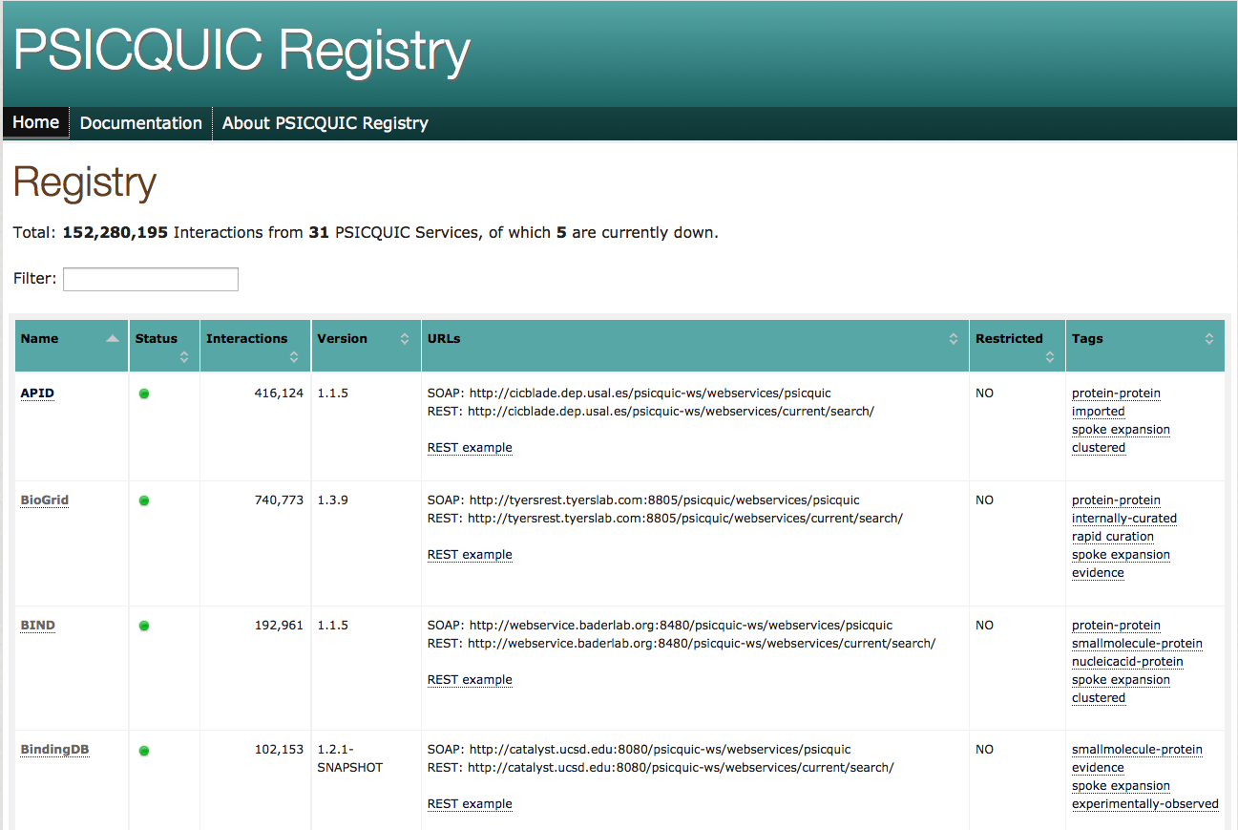
PSICQUIC registry
www.ebi.ac.uk/Tools/webservices/psicquic/registry/registry?action=STATUS
S. Orchard & P. Porras Millán, IntAct

Slide 47
PPI (web) resources

Slide 48
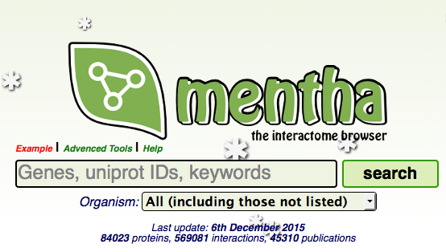
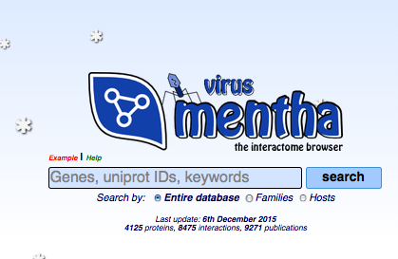
MENTHA and VIRUS MENTHA
An interactome browser that offers protein-protein physical/enzymatic interaction information integrated from various sources. Its data comes from manually curated protein-protein interaction databases
virus mentha archives evidence about viral protein-protein interactions Viruses vs Hosts and viceversa - evidence collected from different databases that have adhered to the IMEx consortium.

Slide 49
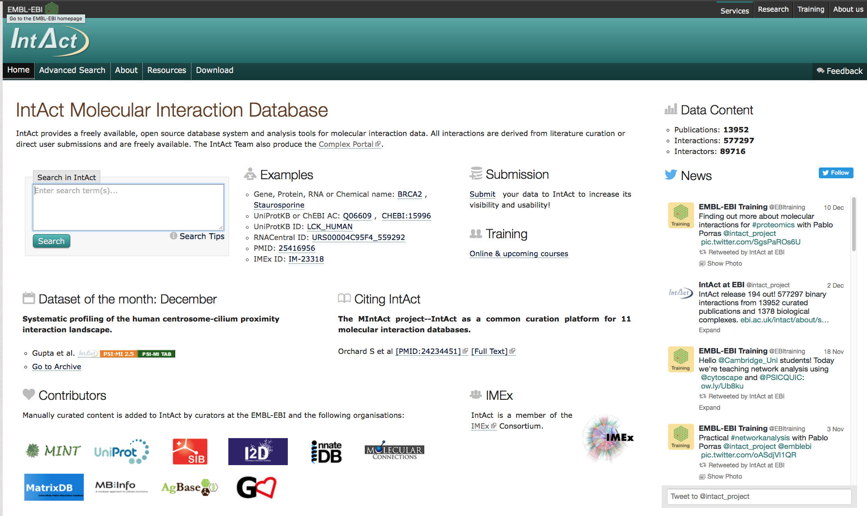
The IntAct database
IntAct Home Page (http://www.ebi.ac.uk/intact/)
Creb1

Slide 50
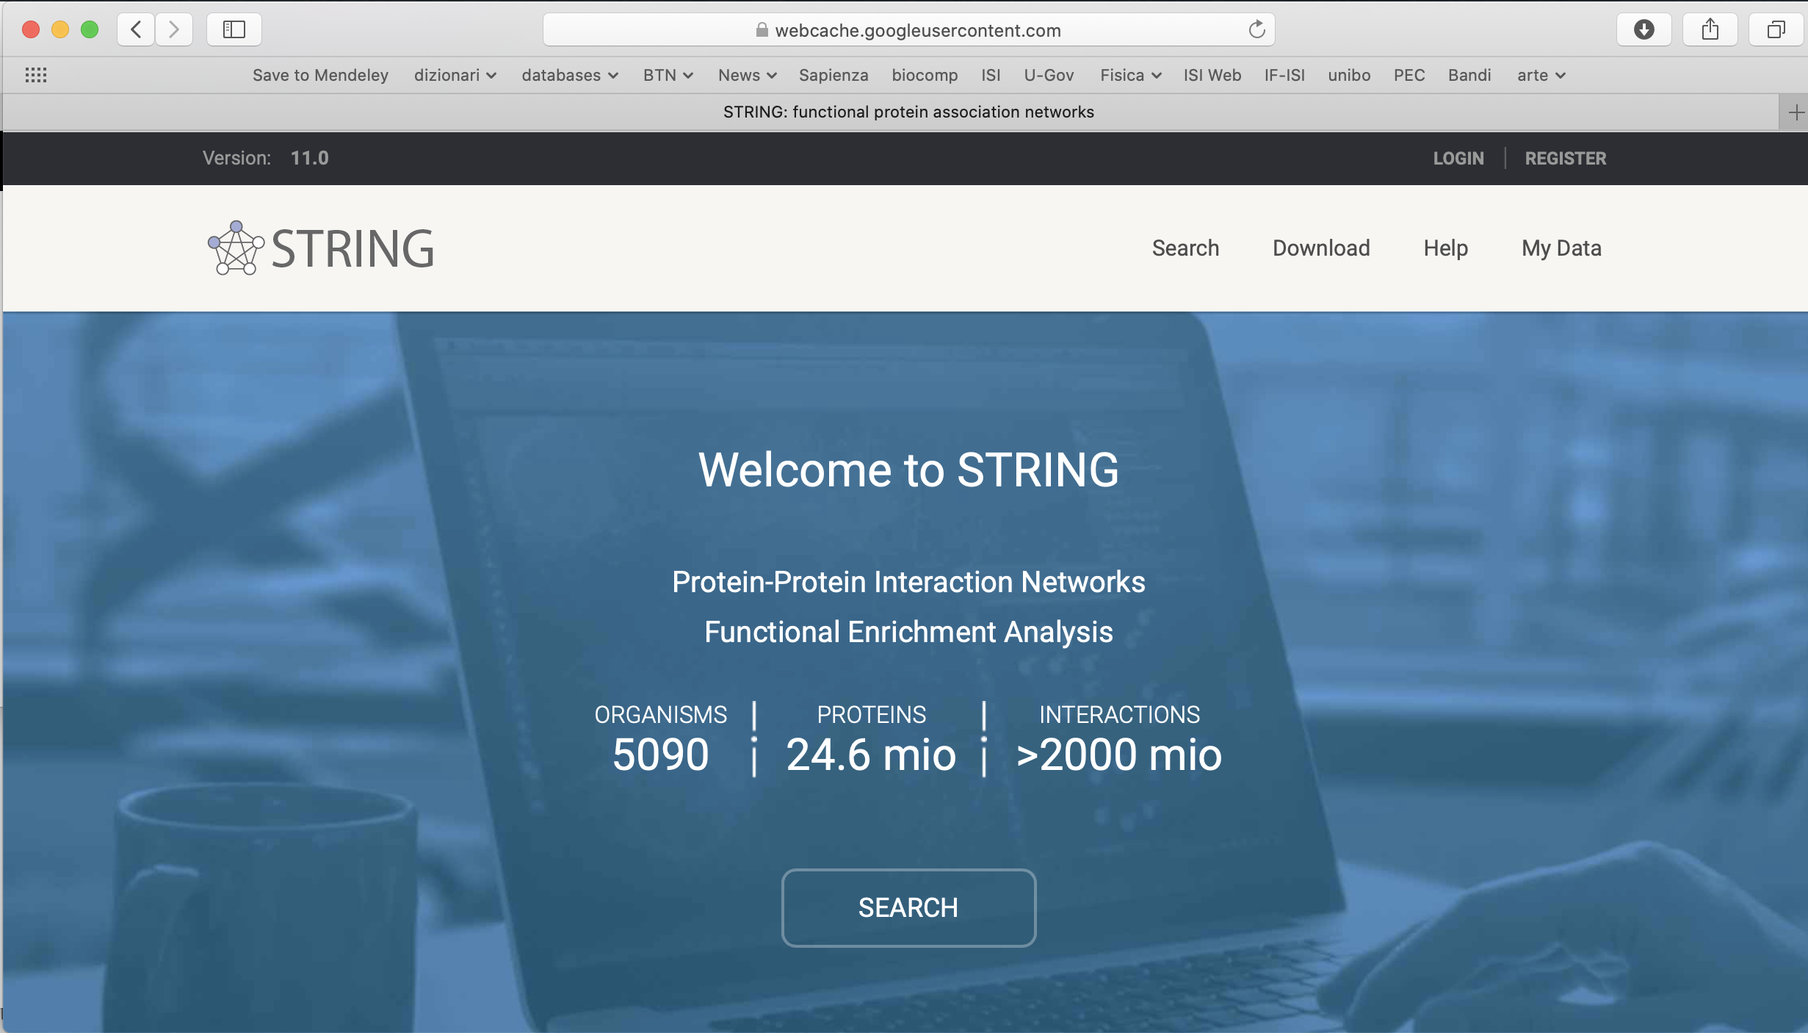
https://string-db.org

